Slide 1

Rescheduling the NBA regular season via Integer Programming
NICOLÁS GARCÍA ARAMOUNI & JUAN JOSÉ MIRANDA BRONT UNIVERSIDAD TORCUATO DI TELLA (BUENOS AIRES, ARGENTINA) JULY 2023

Slide 2
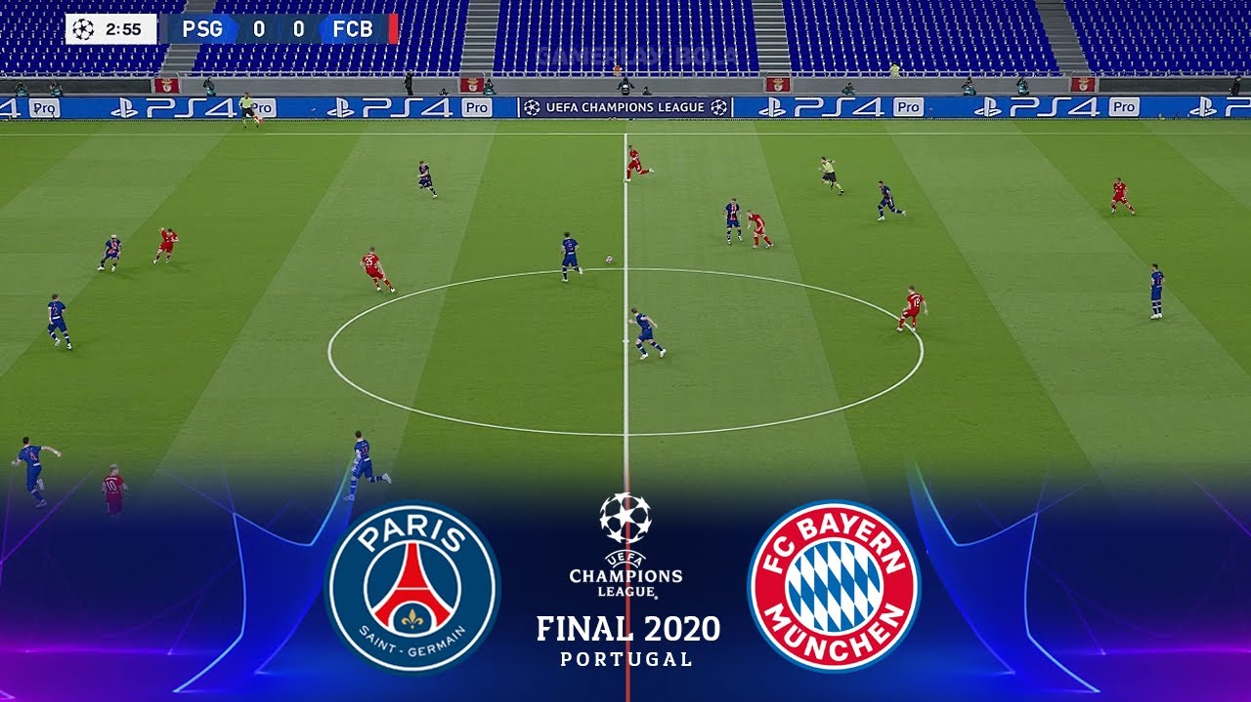
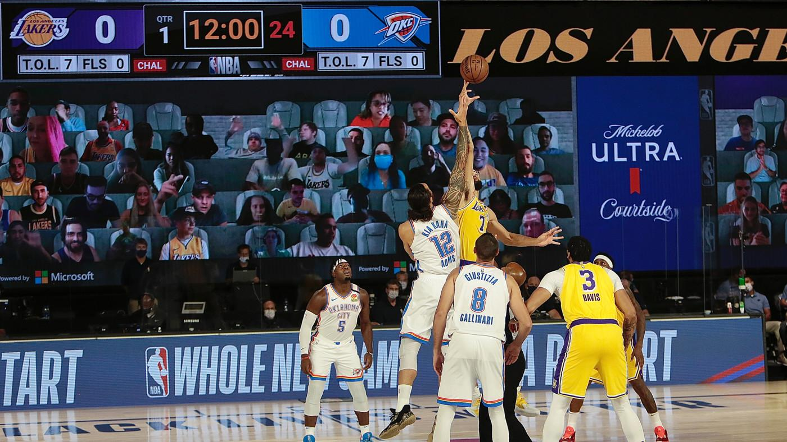
Impact in sport leagues around the world
UEFA Champions
League Final
(2020)
NBA Bubble (2019 - 2020)

Slide 3
Rescheduling matches pre and post COVID
Pre-COVID
COVID
34%
Probability of a match being suspended in the NBA 2020-21 season, given than the previous match was suspended
Suspended matches are rare
Suspensions are usually not related to each other
Suspended matches are more common due to the health situation
If multiple players become sick, consecutive games might be suspended

Slide 4



Rescheduling in sports
Two types of responses
Proactive
Reactive
Literature
Yi et al (EJOR, 2020) present proactive and reactive strategies for time-constrained schedules
Yi et al (ANOR, 2022) present proactive and reactive strategies for time-relaxed schedules
Practice
Leagues like NBA, NHL and MLB have rescheduled games, but haven’t disclosed their methodological approach
Rescheduling necessities

Slide 5
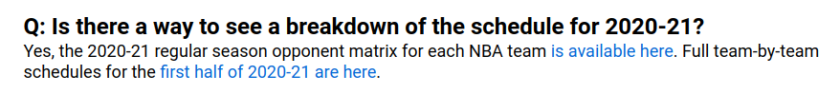
The 2020 - 2021 NBA Season
The NBA applied the following contingency actions during the season:
Proactive scheduling strategy:
Schedule only the first half of the season (All-Star Game);
Postpone games if a teams has insufficient players to the second half;
Generate a schedule for the second half + suspended games
Ad-hoc reschedule for games suspended during the second half.
72
Games per team
31
Suspended games
3%
Games suspended

Slide 6
Our approach: a reactive strategy
Definition
Each game in the executed timetable that is played before or after its scheduled round is considered a disruption. In our setup, each suspended game will therefore translate into a disruption that needs to be rescheduled in the remaining of the season schedule
Research Question
Can we systematically generate an adjusted fixture by rescheduling postponed games within the planned schedule?
Approach: a reactive strategy
Consider as input the planned schedule for the entire season.
Insert the disrupted matches onto the existing schedule, maintaining the original scheduled dates for non-disrupted matches
We build a linear optimization model to find the best possible date for each disruption and, if we can’t, we reschedule it after the end of the schedule’s original date

Slide 7
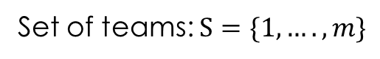
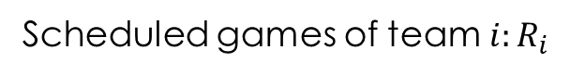
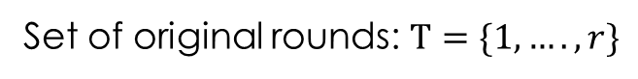
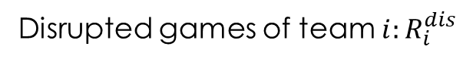
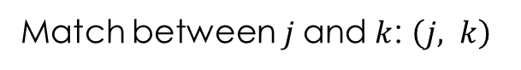
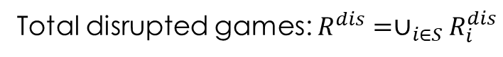
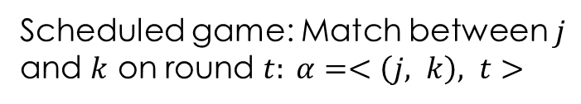
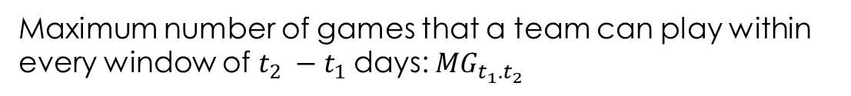
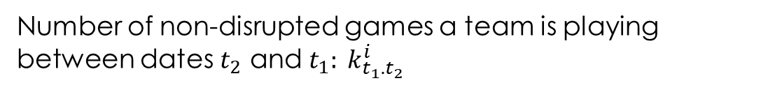
Notations and Definitions
General
Schedule Rules
Decision variables
x_{𝛂t} = 1 iff disrupted game 𝛂 is rescheduled into round t

Slide 8
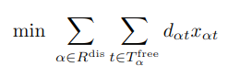
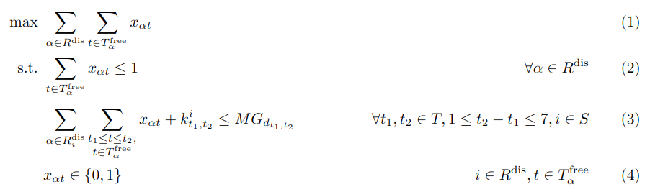
Mathematical Model (MinD)
Minimize total day difference with the original schedule
Games with feasible dates are rescheduled
=
Satisfy maximum number of games in [t₁, t₂]

Slide 9
Preliminary Experiments
Rescheduled dates for postponed games are not considered as part of the input schedule (except for some special configurations)
We consider the following metrics:
Classical from scheduling: distance, breaks.
New: # of day added and # of games played after the end of the season in the planned schedule.
Models and algorithms implemented in Python + CPLEX.

Slide 10
Rescheduling Strategy
In order to get a better understanding of the performance of our solution we try to replicate the rescheduling process for the suspended games of the 2020-21 NBA season
Rescheduling methodology
Post All-Star
Dec-Jan-Feb
Mar
Apr
May
Wait until the All-Star break to reschedule first set of matches, then follow the monthly approach
At the end of each month, we reschedule the disruptions that happened there.
We consider the rest of the season.
Post All Star*
Use the NBA’s reschedules if they happened within the rescheduled window.

Slide 11
Main Results
Number of additional days needed after the end of the season
Metric | NBA exec | Post All Star | Post All Star*
Distance | -0.2% | 0.03% | 0.35%
Breaks | 0.6% | 0.3% | 0.5%
# Dates Added | - | 5 | 0
Games After | - | 5 | 0
Exec. Time |  | 5.98 min | 5.62 min
A
Number of games scheduled after the end of the season
B
Key Takeouts
All differences are small
(<1%)
The NBA’s proactive approach has effects on the additional number of dates needed
A
B

Slide 12
Further Disruptions Scenarios
We consider instances stressing the number and timing of the disruptions:
15 more games: ~50% increase in the problem size
25 more games: ~80% increase in the problem size
15 more March games: Similar to a second COVID wave
Instance / Metric | Distance | Breaks | # dates added | Games after | Exec. Time
15 more games | 3.4% | -0.7% | 11 | 17 | 8.13 min
25 more games | 5.1% | -0.6% | 12 | 23 | 8.06 min
15 more games in March | 1.3% | 0.1% | 9 | 20 | 7.61 min
A
Difference against the planned NBA schedule, post All-Star strategy
A
Effects on relevant KPIs is not negligible

Slide 13
How can we improve the existing solution
Given the current result, especially the effect on relevant KPIs of bigger instances, we might consider that a different approach is necessary:
Example
If we wanted to schedule a disruption, we would have to do it on day 6
Day | 1 | 2 | 3 | 4 | 5 | 6
Match
In this sense, we can think about matches swaps and switches!
Day | 1 | 2 | 3 | 4 | 5 | 6
Match
If we could move the game in day 3 to day 2, we could complete the schedule in 5 days

Slide 14
Beware of the modifications!
Example: Original Schedule
Home Tour
Away Tour
Match | 1 | 2 | 3 | 4 | 5 | 6
Rival | A | B | C | @D | @E | @F
Our current approach might change the tour order, increasing the total distance travelled
Changed Schedule
Day | 1 | 2 | 3 | 4 | 5 | 6
Match | A | @D | C | @E | B | @F

Slide 15
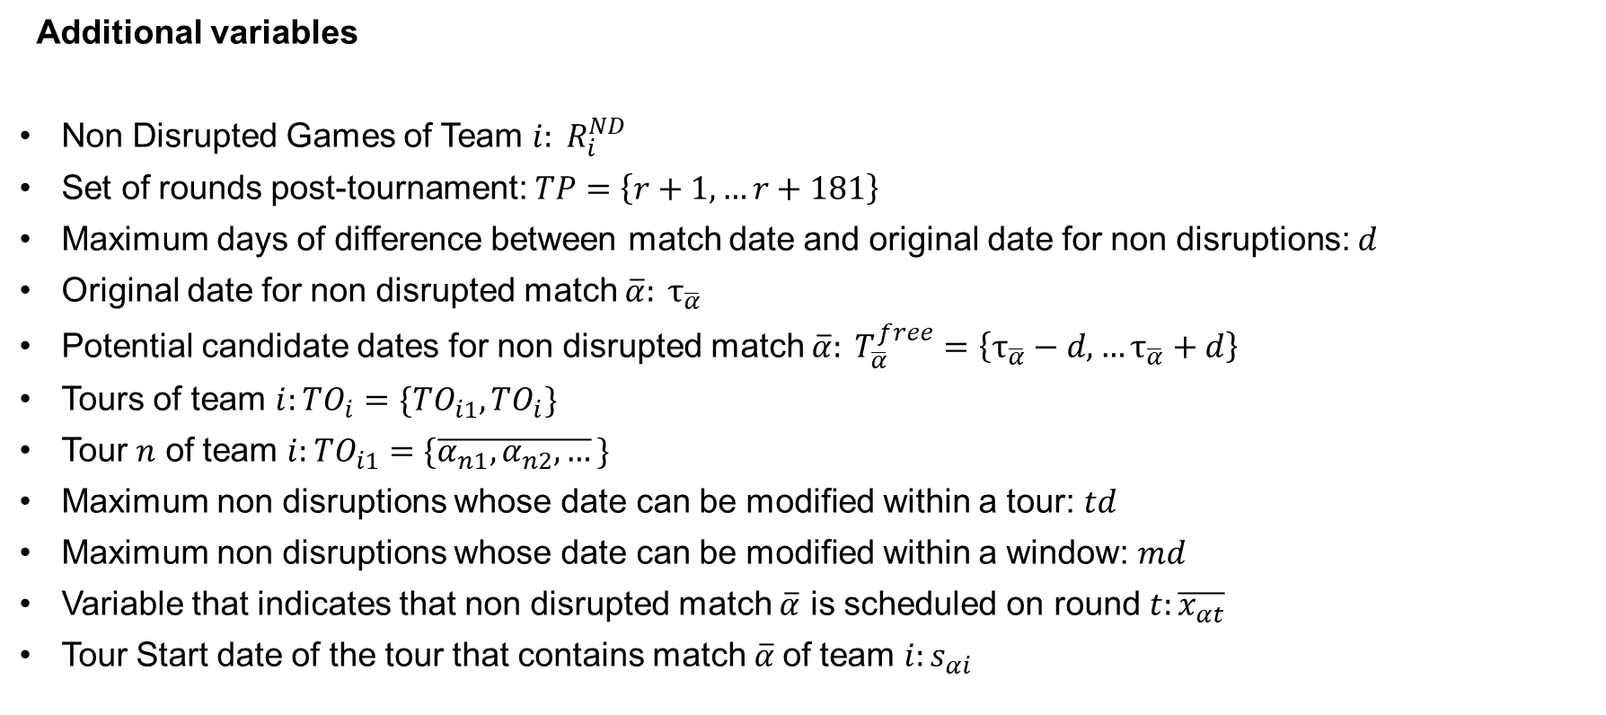
How can we adapt the existing model?
Additional variables
Non Disrupted Games of Team $i: R_{i}^{ND}$
Set of rounds post-tournament: $TP=\left\{r+1,…r+181\right\}$
Maximum days of difference between match date and original date for non disruptions: $d$
Original date for non disrupted match $\overline{α}: τ_{\overline{α}}$
Potential candidate dates for non disrupted match $\overline{α}: T_{\overline{α}}^{free}=\left\{τ_{\overline{α}}−d,…τ_{\overline{α}}+d\right\}$
Tours of team $i:TO_{i}=\{TO_{i1},TO_{i}\}$
Tour $n$ of team $i:TO_{i1}=\{\overline{α_{n1},α_{n2},…}\}$
Maximum non disruptions whose date can be modified within a tour: $td$
Maximum non disruptions whose date can be modified within a window: $md$
Variable that indicates that non disrupted match $\overline{α}$ is scheduled on round $t:\overline{x_{αt}}$
Tour Start date of the tour that contains match $\overline{α}$of team $i:s_{αi}$

Slide 16
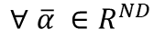
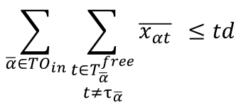
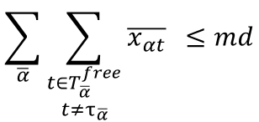
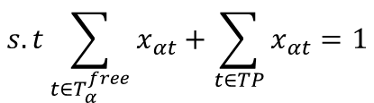
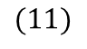
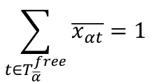
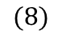
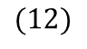
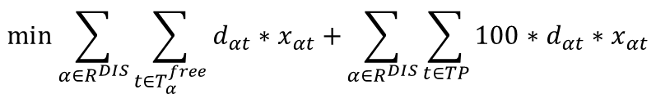
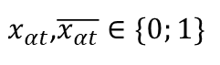
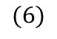
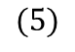
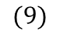
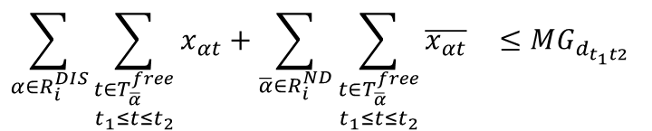
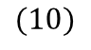
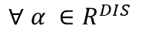
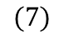
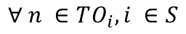
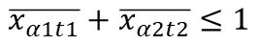
New mathematical model
$$\min{\sum_{α∈R^{DIS}}{\sum_{t∈T_{α}^{free}}{d_{αt}∗x_{αt}+}}}\sum_{α∈R^{DIS}}{\sum_{t∈TP}{{100∗d}_{αt}∗x_{αt}}}$$
$$(5)$$
$$s.t\sum_{t∈T_{α}^{free}}{x_{αt}+\sum_{t∈TP}{x_{αt}}=1}$$
$$(6)$$
$$∀ α ∈R^{DIS}$$
$$\sum_{t∈T_{\overline{α}}^{free}}{\overline{x_{αt}}=1}$$
$$∀ \overline{α} ∈R^{ND}$$
$$(7)$$
$$\sum_{α∈R_{i}^{DIS}}{\sum_{\begin{aligned}t∈T_{\overline{α}}^{free} \\ t_{1}≤t≤t_{2}\end{aligned}}{x_{αt}+\sum_{\overline{α}∈R_{i}^{ND}}{\sum_{\begin{aligned}t∈T_{\overline{α}}^{free} \\ t_{1}≤t≤t_{2}\end{aligned}}{\overline{x_{αt}}} } ≤MG_{d_{t_{1}t2}}} }$$
$$∀ t_{1},t_{2}∈T∪TP, 1≤t_{2}−t_{1}≤7, i ∈S$$
$$(8)$$
$$\sum_{\overline{α}∈{TO}_{in}}{\sum_{\begin{aligned}t∈T_{\overline{α}}^{free} \\ t≠τ_{\overline{α}}\end{aligned}}{\overline{x_{αt}}} ≤td}$$
$$∀ n ∈TO_{i}, i ∈S$$
$$(9)$$
$$\sum_{\overline{α}}{\sum_{\begin{aligned}t∈T_{\overline{α}}^{free} \\ t≠τ_{\overline{α}}\end{aligned}}{\overline{x_{αt}}} ≤md}$$
$$(10)$$
$\overline{x_{α1t1}}+\overline{x_{α2t2}}≤1$
$$∀α2,α1∈R_{i}^{ND}, i ∈S,s_{a1}>s_{a2}, t_{1}<t_{2}$$
$$(11)$$
$x_{αt}$,$\overline{x_{αt}}∈\{0;1\}$
$$(12)$$

Slide 17
New mathematical model
Minimize Day Difference Between Original and Final Date
$$\min{\sum_{α∈R^{DIS}}{\sum_{t∈T_{α}^{free}}{d_{αt}∗x_{αt}+}}}\sum_{α∈R^{DIS}}{\sum_{t∈TP}{{100∗d}_{αt}∗x_{αt}}}$$
$$(5)$$
$$s.t\sum_{t∈T_{α}^{free}}{x_{αt}+\sum_{t∈TP}{x_{αt}}=1}$$
$$(6)$$
$$∀ α ∈R^{DIS}$$
$$\sum_{t∈T_{\overline{α}}^{free}}{\overline{x_{αt}}=1}$$
$$∀ \overline{α} ∈R^{ND}$$
$$(7)$$
$$\sum_{α∈R_{i}^{DIS}}{\sum_{\begin{aligned}t∈T_{\overline{α}}^{free} \\ t_{1}≤t≤t_{2}\end{aligned}}{x_{αt}+\sum_{\overline{α}∈R_{i}^{ND}}{\sum_{\begin{aligned}t∈T_{\overline{α}}^{free} \\ t_{1}≤t≤t_{2}\end{aligned}}{\overline{x_{αt}}} } ≤MG_{d_{t_{1}t2}}} }$$
$$∀ t_{1},t_{2}∈T∪TP, 1≤t_{2}−t_{1}≤7, i ∈S$$
$$(8)$$
$$\sum_{\overline{α}∈{TO}_{in}}{\sum_{\begin{aligned}t∈T_{\overline{α}}^{free} \\ t≠τ_{\overline{α}}\end{aligned}}{\overline{x_{αt}}} ≤td}$$
$$∀ n ∈TO_{i}, i ∈S$$
$$(9)$$
$$\sum_{\overline{α}}{\sum_{\begin{aligned}t∈T_{\overline{α}}^{free} \\ t≠τ_{\overline{α}}\end{aligned}}{\overline{x_{αt}}} ≤md}$$
$$(10)$$
$\overline{x_{α1t1}}+\overline{x_{α2t2}}≤1$
$$∀α2,α1∈R_{i}^{ND}, i ∈S,s_{a1}>s_{a2}, t_{1}<t_{2}$$
$$(11)$$
$x_{αt}$,$\overline{x_{αt}}∈\{0;1\}$
$$(12)$$

Slide 18
New mathematical model
$$\min{\sum_{α∈R^{DIS}}{\sum_{t∈T_{α}^{free}}{d_{αt}∗x_{αt}+}}}\sum_{α∈R^{DIS}}{\sum_{t∈TP}{{100∗d}_{αt}∗x_{αt}}}$$
$$(5)$$
All disruptions should be scheduled in existing or extra dates
$$s.t\sum_{t∈T_{α}^{free}}{x_{αt}+\sum_{t∈TP}{x_{αt}}=1}$$
$$(6)$$
$$∀ α ∈R^{DIS}$$
$$\sum_{t∈T_{\overline{α}}^{free}}{\overline{x_{αt}}=1}$$
$$∀ \overline{α} ∈R^{ND}$$
$$(7)$$
$$\sum_{α∈R_{i}^{DIS}}{\sum_{\begin{aligned}t∈T_{\overline{α}}^{free} \\ t_{1}≤t≤t_{2}\end{aligned}}{x_{αt}+\sum_{\overline{α}∈R_{i}^{ND}}{\sum_{\begin{aligned}t∈T_{\overline{α}}^{free} \\ t_{1}≤t≤t_{2}\end{aligned}}{\overline{x_{αt}}} } ≤MG_{d_{t_{1}t2}}} }$$
$$∀ t_{1},t_{2}∈T∪TP, 1≤t_{2}−t_{1}≤7, i ∈S$$
$$(8)$$
$$\sum_{\overline{α}∈{TO}_{in}}{\sum_{\begin{aligned}t∈T_{\overline{α}}^{free} \\ t≠τ_{\overline{α}}\end{aligned}}{\overline{x_{αt}}} ≤td}$$
$$∀ n ∈TO_{i}, i ∈S$$
$$(9)$$
$$\sum_{\overline{α}}{\sum_{\begin{aligned}t∈T_{\overline{α}}^{free} \\ t≠τ_{\overline{α}}\end{aligned}}{\overline{x_{αt}}} ≤md}$$
$$(10)$$
$\overline{x_{α1t1}}+\overline{x_{α2t2}}≤1$
$$∀α2,α1∈R_{i}^{ND}, i ∈S,s_{a1}>s_{a2}, t_{1}<t_{2}$$
$$(11)$$
$x_{αt}$,$\overline{x_{αt}}∈\{0;1\}$
$$(12)$$

Slide 19
New mathematical model
$$\min{\sum_{α∈R^{DIS}}{\sum_{t∈T_{α}^{free}}{d_{αt}∗x_{αt}+}}}\sum_{α∈R^{DIS}}{\sum_{t∈TP}{{100∗d}_{αt}∗x_{αt}}}$$
$$(5)$$
$$s.t\sum_{t∈T_{α}^{free}}{x_{αt}+\sum_{t∈TP}{x_{αt}}=1}$$
$$(6)$$
$$∀ α ∈R^{DIS}$$
All non disruptions should be scheduled in possible dates
$$\sum_{t∈T_{\overline{α}}^{free}}{\overline{x_{αt}}=1}$$
$$∀ \overline{α} ∈R^{ND}$$
$$(7)$$
$$\sum_{α∈R_{i}^{DIS}}{\sum_{\begin{aligned}t∈T_{\overline{α}}^{free} \\ t_{1}≤t≤t_{2}\end{aligned}}{x_{αt}+\sum_{\overline{α}∈R_{i}^{ND}}{\sum_{\begin{aligned}t∈T_{\overline{α}}^{free} \\ t_{1}≤t≤t_{2}\end{aligned}}{\overline{x_{αt}}} } ≤MG_{d_{t_{1}t2}}} }$$
$$∀ t_{1},t_{2}∈T∪TP, 1≤t_{2}−t_{1}≤7, i ∈S$$
$$(8)$$
$$\sum_{\overline{α}∈{TO}_{in}}{\sum_{\begin{aligned}t∈T_{\overline{α}}^{free} \\ t≠τ_{\overline{α}}\end{aligned}}{\overline{x_{αt}}} ≤td}$$
$$∀ n ∈TO_{i}, i ∈S$$
$$(9)$$
$$\sum_{\overline{α}}{\sum_{\begin{aligned}t∈T_{\overline{α}}^{free} \\ t≠τ_{\overline{α}}\end{aligned}}{\overline{x_{αt}}} ≤md}$$
$$(10)$$
$\overline{x_{α1t1}}+\overline{x_{α2t2}}≤1$
$$∀α2,α1∈R_{i}^{ND}, i ∈S,s_{a1}>s_{a2}, t_{1}<t_{2}$$
$$(11)$$
$x_{αt}$,$\overline{x_{αt}}∈\{0;1\}$
$$(12)$$

Slide 20
New mathematical model
$$\min{\sum_{α∈R^{DIS}}{\sum_{t∈T_{α}^{free}}{d_{αt}∗x_{αt}+}}}\sum_{α∈R^{DIS}}{\sum_{t∈TP}{{100∗d}_{αt}∗x_{αt}}}$$
$$(5)$$
$$s.t\sum_{t∈T_{α}^{free}}{x_{αt}+\sum_{t∈TP}{x_{αt}}=1}$$
$$(6)$$
$$∀ α ∈R^{DIS}$$
$$\sum_{t∈T_{\overline{α}}^{free}}{\overline{x_{αt}}=1}$$
$$∀ \overline{α} ∈R^{ND}$$
$$(7)$$
Schedule rules must be followed
$$\sum_{α∈R_{i}^{DIS}}{\sum_{\begin{aligned}t∈T_{\overline{α}}^{free} \\ t_{1}≤t≤t_{2}\end{aligned}}{x_{αt}+\sum_{\overline{α}∈R_{i}^{ND}}{\sum_{\begin{aligned}t∈T_{\overline{α}}^{free} \\ t_{1}≤t≤t_{2}\end{aligned}}{\overline{x_{αt}}} } ≤MG_{d_{t_{1}t2}}} }$$
$$∀ t_{1},t_{2}∈T∪TP, 1≤t_{2}−t_{1}≤7, i ∈S$$
$$(8)$$
$$\sum_{\overline{α}∈{TO}_{in}}{\sum_{\begin{aligned}t∈T_{\overline{α}}^{free} \\ t≠τ_{\overline{α}}\end{aligned}}{\overline{x_{αt}}} ≤td}$$
$$∀ n ∈TO_{i}, i ∈S$$
$$(9)$$
$$\sum_{\overline{α}}{\sum_{\begin{aligned}t∈T_{\overline{α}}^{free} \\ t≠τ_{\overline{α}}\end{aligned}}{\overline{x_{αt}}} ≤md}$$
$$(10)$$
$\overline{x_{α1t1}}+\overline{x_{α2t2}}≤1$
$$∀α2,α1∈R_{i}^{ND}, i ∈S,s_{a1}>s_{a2}, t_{1}<t_{2}$$
$$(11)$$
$x_{αt}$,$\overline{x_{αt}}∈\{0;1\}$
$$(12)$$

Slide 21
New mathematical model
$$\min{\sum_{α∈R^{DIS}}{\sum_{t∈T_{α}^{free}}{d_{αt}∗x_{αt}+}}}\sum_{α∈R^{DIS}}{\sum_{t∈TP}{{100∗d}_{αt}∗x_{αt}}}$$
$$(5)$$
$$s.t\sum_{t∈T_{α}^{free}}{x_{αt}+\sum_{t∈TP}{x_{αt}}=1}$$
$$(6)$$
$$∀ α ∈R^{DIS}$$
$$\sum_{t∈T_{\overline{α}}^{free}}{\overline{x_{αt}}=1}$$
$$∀ \overline{α} ∈R^{ND}$$
$$(7)$$
$$\sum_{α∈R_{i}^{DIS}}{\sum_{\begin{aligned}t∈T_{\overline{α}}^{free} \\ t_{1}≤t≤t_{2}\end{aligned}}{x_{αt}+\sum_{\overline{α}∈R_{i}^{ND}}{\sum_{\begin{aligned}t∈T_{\overline{α}}^{free} \\ t_{1}≤t≤t_{2}\end{aligned}}{\overline{x_{αt}}} } ≤MG_{d_{t_{1}t2}}} }$$
$$∀ t_{1},t_{2}∈T∪TP, 1≤t_{2}−t_{1}≤7, i ∈S$$
$$(8)$$
No more tan td non disruptions can be changed per tour
$$\sum_{\overline{α}∈{TO}_{in}}{\sum_{\begin{aligned}t∈T_{\overline{α}}^{free} \\ t≠τ_{\overline{α}}\end{aligned}}{\overline{x_{αt}}} ≤td}$$
$$∀ n ∈TO_{i}, i ∈S$$
$$(9)$$
$$\sum_{\overline{α}}{\sum_{\begin{aligned}t∈T_{\overline{α}}^{free} \\ t≠τ_{\overline{α}}\end{aligned}}{\overline{x_{αt}}} ≤md}$$
$$(10)$$
$\overline{x_{α1t1}}+\overline{x_{α2t2}}≤1$
$$∀α2,α1∈R_{i}^{ND}, i ∈S,s_{a1}>s_{a2}, t_{1}<t_{2}$$
$$(11)$$
$x_{αt}$,$\overline{x_{αt}}∈\{0;1\}$
$$(12)$$

Slide 22
New mathematical model
$$\min{\sum_{α∈R^{DIS}}{\sum_{t∈T_{α}^{free}}{d_{αt}∗x_{αt}+}}}\sum_{α∈R^{DIS}}{\sum_{t∈TP}{{100∗d}_{αt}∗x_{αt}}}$$
$$(5)$$
$$s.t\sum_{t∈T_{α}^{free}}{x_{αt}+\sum_{t∈TP}{x_{αt}}=1}$$
$$(6)$$
$$∀ α ∈R^{DIS}$$
$$\sum_{t∈T_{\overline{α}}^{free}}{\overline{x_{αt}}=1}$$
$$∀ \overline{α} ∈R^{ND}$$
$$(7)$$
$$\sum_{α∈R_{i}^{DIS}}{\sum_{\begin{aligned}t∈T_{\overline{α}}^{free} \\ t_{1}≤t≤t_{2}\end{aligned}}{x_{αt}+\sum_{\overline{α}∈R_{i}^{ND}}{\sum_{\begin{aligned}t∈T_{\overline{α}}^{free} \\ t_{1}≤t≤t_{2}\end{aligned}}{\overline{x_{αt}}} } ≤MG_{d_{t_{1}t2}}} }$$
$$∀ t_{1},t_{2}∈T∪TP, 1≤t_{2}−t_{1}≤7, i ∈S$$
$$(8)$$
$$\sum_{\overline{α}∈{TO}_{in}}{\sum_{\begin{aligned}t∈T_{\overline{α}}^{free} \\ t≠τ_{\overline{α}}\end{aligned}}{\overline{x_{αt}}} ≤td}$$
$$∀ n ∈TO_{i}, i ∈S$$
$$(9)$$
No more tan md non disruptions can be changed
$$\sum_{\overline{α}}{\sum_{\begin{aligned}t∈T_{\overline{α}}^{free} \\ t≠τ_{\overline{α}}\end{aligned}}{\overline{x_{αt}}} ≤md}$$
$$(10)$$
$\overline{x_{α1t1}}+\overline{x_{α2t2}}≤1$
$$∀α2,α1∈R_{i}^{ND}, i ∈S,s_{a1}>s_{a2}, t_{1}<t_{2}$$
$$(11)$$
$x_{αt}$,$\overline{x_{αt}}∈\{0;1\}$
$$(12)$$

Slide 23
New mathematical model
$$\min{\sum_{α∈R^{DIS}}{\sum_{t∈T_{α}^{free}}{d_{αt}∗x_{αt}+}}}\sum_{α∈R^{DIS}}{\sum_{t∈TP}{{100∗d}_{αt}∗x_{αt}}}$$
$$(5)$$
$$s.t\sum_{t∈T_{α}^{free}}{x_{αt}+\sum_{t∈TP}{x_{αt}}=1}$$
$$(6)$$
$$∀ α ∈R^{DIS}$$
$$\sum_{t∈T_{\overline{α}}^{free}}{\overline{x_{αt}}=1}$$
$$∀ \overline{α} ∈R^{ND}$$
$$(7)$$
$$\sum_{α∈R_{i}^{DIS}}{\sum_{\begin{aligned}t∈T_{\overline{α}}^{free} \\ t_{1}≤t≤t_{2}\end{aligned}}{x_{αt}+\sum_{\overline{α}∈R_{i}^{ND}}{\sum_{\begin{aligned}t∈T_{\overline{α}}^{free} \\ t_{1}≤t≤t_{2}\end{aligned}}{\overline{x_{αt}}} } ≤MG_{d_{t_{1}t2}}} }$$
$$∀ t_{1},t_{2}∈T∪TP, 1≤t_{2}−t_{1}≤7, i ∈S$$
$$(8)$$
$$\sum_{\overline{α}∈{TO}_{in}}{\sum_{\begin{aligned}t∈T_{\overline{α}}^{free} \\ t≠τ_{\overline{α}}\end{aligned}}{\overline{x_{αt}}} ≤td}$$
$$∀ n ∈TO_{i}, i ∈S$$
$$(9)$$
$$\sum_{\overline{α}}{\sum_{\begin{aligned}t∈T_{\overline{α}}^{free} \\ t≠τ_{\overline{α}}\end{aligned}}{\overline{x_{αt}}} ≤md}$$
$$(10)$$
Avoid tours being overlapped with modifiations
$\overline{x_{α1t1}}+\overline{x_{α2t2}}≤1$
$$∀α2,α1∈R_{i}^{ND}, i ∈S,s_{a1}>s_{a2}, t_{1}<t_{2}$$
$$(11)$$
$x_{αt}$,$\overline{x_{αt}}∈\{0;1\}$
$$(12)$$

Slide 24
New mathematical model
$$\min{\sum_{α∈R^{DIS}}{\sum_{t∈T_{α}^{free}}{d_{αt}∗x_{αt}+}}}\sum_{α∈R^{DIS}}{\sum_{t∈TP}{{100∗d}_{αt}∗x_{αt}}}$$
$$(5)$$
$$s.t\sum_{t∈T_{α}^{free}}{x_{αt}+\sum_{t∈TP}{x_{αt}}=1}$$
$$(6)$$
$$∀ α ∈R^{DIS}$$
$$\sum_{t∈T_{\overline{α}}^{free}}{\overline{x_{αt}}=1}$$
$$∀ \overline{α} ∈R^{ND}$$
$$(7)$$
$$\sum_{α∈R_{i}^{DIS}}{\sum_{\begin{aligned}t∈T_{\overline{α}}^{free} \\ t_{1}≤t≤t_{2}\end{aligned}}{x_{αt}+\sum_{\overline{α}∈R_{i}^{ND}}{\sum_{\begin{aligned}t∈T_{\overline{α}}^{free} \\ t_{1}≤t≤t_{2}\end{aligned}}{\overline{x_{αt}}} } ≤MG_{d_{t_{1}t2}}} }$$
$$∀ t_{1},t_{2}∈T∪TP, 1≤t_{2}−t_{1}≤7, i ∈S$$
$$(8)$$
$$\sum_{\overline{α}∈{TO}_{in}}{\sum_{\begin{aligned}t∈T_{\overline{α}}^{free} \\ t≠τ_{\overline{α}}\end{aligned}}{\overline{x_{αt}}} ≤td}$$
$$∀ n ∈TO_{i}, i ∈S$$
$$(9)$$
$$\sum_{\overline{α}}{\sum_{\begin{aligned}t∈T_{\overline{α}}^{free} \\ t≠τ_{\overline{α}}\end{aligned}}{\overline{x_{αt}}} ≤md}$$
$$(10)$$
Variable domain
$\overline{x_{α1t1}}+\overline{x_{α2t2}}≤1$
$$∀α2,α1∈R_{i}^{ND}, i ∈S,s_{a1}>s_{a2}, t_{1}<t_{2}$$
$$(11)$$
$x_{αt}$,$\overline{x_{αt}}∈\{0;1\}$
$$(12)$$

Slide 25
Effects on relevant KPIs
To get an understanding on the effect of this possible changes, let’s analyze the results with a Post All Star scheduling strategy with our biggest instance: original disruptions + 25 new ones, where the maximum number of non-disruptions to be changed by window is 10:
A
B
When we increase the potential adjustment, logically, total distance increases
However, the number of additional dates needed to complete the tournament decreases
A
B
* Against original planned schedule

Slide 26
Effects on relevant KPIs
To get an understanding on the effect of this possible changes, let’s analyze the results with a Post All Star scheduling strategy with our biggest instance: original disruptions + 25 new ones, where the maximum number of non-disruptions to be changed by window is 10:
A
B
The possibility to reschedule more games increases complexity, although relationship is not clear
2% of the total games are being modified, which is similar to the number of disruptions
A
B
* Against original planned schedule

Slide 27
Summary
We framed the problem of rescheduling in time-relaxed tournaments
We evaluate different rescheduling strategies building on MIP models
Initial results show we are obtaining similar results than the ones produced by the NBA
More stressed disrupted scenarios have a considerable impact on relevant KPIs
Schedule modifications may help reduce the impact of multiple disruptions on more stressed scenarios
Next steps
Limit potential changes in order to find a good balance between additional dates needed to complete a schedule and total distance travelled
Elaborate new model that enumerates potential tour changes and finds a schedule that generates the minimum distance.

Slide 28
Next Steps
Tour – Sequence 1
Day | 1 | 2 | 3 | 4 | 5 | 6
Match
Tour – Sequence 2
Select the sequence that minimizes distance when rescheduling disruptions
Day | 1 | 2 | 3 | 4 | 5 | 6
Match
Inserted disruption
Tour – Sequence 3
Day | 1 | 2 | 3 | 4 | 5 | 6
Match

Slide 29
CONTENT TITLE

Slide 30
CONTENT TITLE

